Slide 1
Texture Mapping

Slide 2
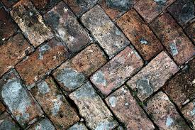
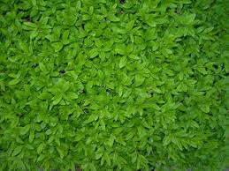
What is Texture ?
Texture:
The feel, appearance, or consistency of a surface or a substance.
…… The natural world is rich in texture: the surface of any visible object is textured at certain scale

Slide 3
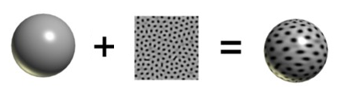
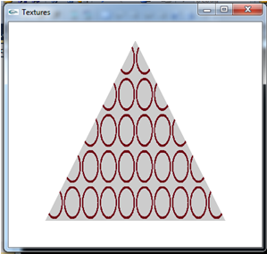


What is Texture Mapping in OpenGL?
Texture Mapping → Texture Wrapping
An object
An image
(jpg, bmp, etc. )
Texture Mapped

Slide 4
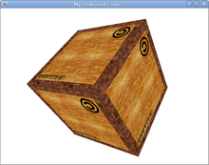
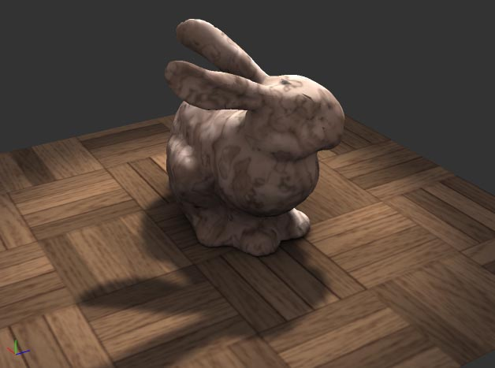
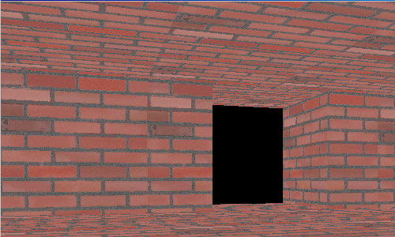
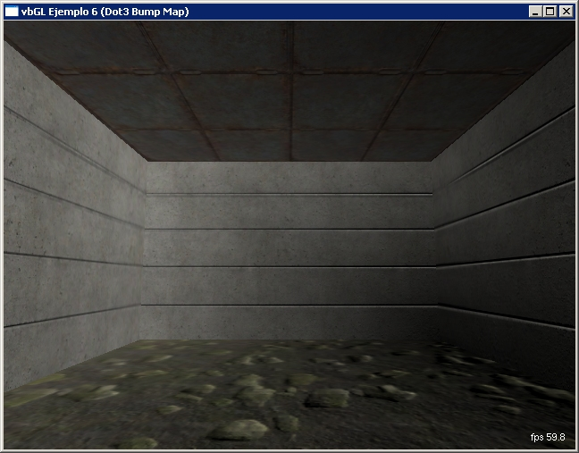
What is Texture Mapping in OpenGL?

Slide 5

Example
(-1, 1,0)
Quad
(1, 1,0)
100
100
Image
(0,0,0)
(-1, -1,0)
(1, -1,0)

Slide 6
Example
(-1, 1,0)
(1, 1,0)
100
100
we can put this image block as tiles on this Quad one by one
(-1, -1,0)
(1, -1,0)

Slide 7
Example
Y
(-1, 1,0)
axis for the Quad
(1, 1,0)
100
(0,0,0)
100
X
(-1, -1,0)
(1, -1,0)

Slide 8
Example
V
Y
axis for the Quad
100
(0,0,0)
100
X
(0,0)
axis for the Image
U

Slide 9
Example
(-1, 1,0)
(1, 1,0)
1
1
(0,0,0)
(U,V) = (0, 0)
(X,Y) = (-1, -1,0)
(1, -1,0)

Slide 10
Example
(-1, 1,0)
(1, 1,0)
(0, 3)
(0,0,0)
(0, 0)
(-1, -1,0)
(1, -1,0)

Slide 11
What is Texture Mapping in OpenGL?
(-1, 1,0)
(1, 1,0)
(0, 3)
(0,0,0)
(3, 0)
(0, 0)
(-1, -1,0)
(1, -1,0)

Slide 12
What is Texture Mapping in OpenGL?
(3, 3)
(-1, 1,0)
(1, 1,0)
(0, 3)
(3, 0)
(0, 0)
(-1, -1,0)
(1, -1,0)

Slide 13
Steps In Texture Mapping.
Step 1 : a) Loading Image
b) Image → OpenGL Texture (To make the image ready for wrapping an object)
Step 2: Mapping that ready texture on the object (Wrapping)

Slide 14

CODE ! ☹
CODES ! CODES!! CODES !!!
Exhausted?

Slide 15

Why So Serious ??? ☺
We don't have to know how it works; all we have to know is what it does

Slide 16
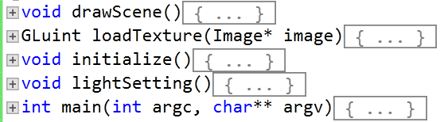
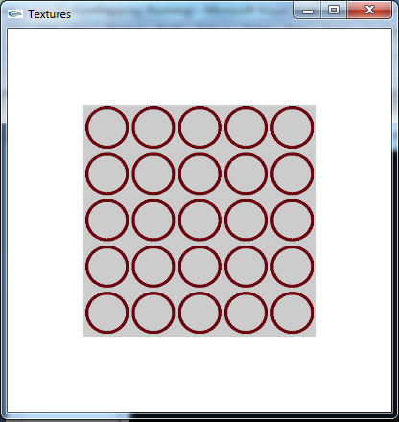
Lets Know - What It Does !

Slide 17

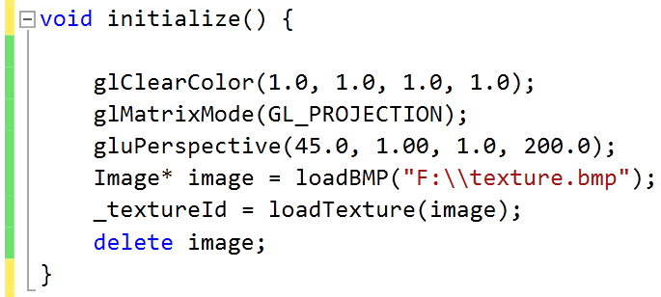
Step 1 : Image → OpenGL Texture

Slide 18
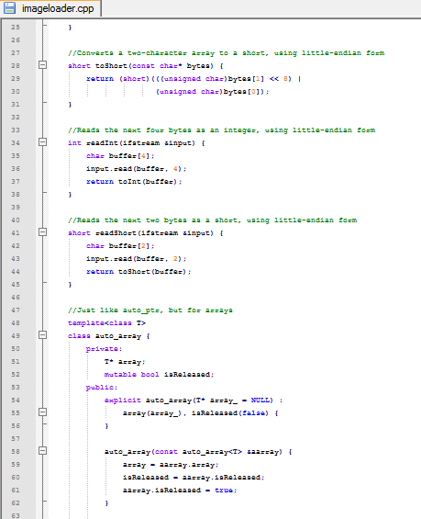
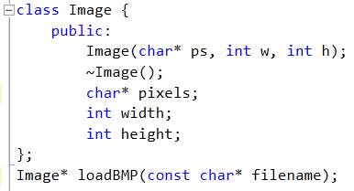
Step 1 : Image → OpenGL Texture
imageloader.cpp
imageloader.h
Detailed Codes

Slide 19

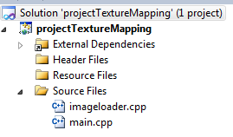
Step 1 : Image → OpenGL Texture
imageloader.cpp
imageloader.h
Detailed Codes

Slide 20
Step 1 : Image → OpenGL Texture

Slide 21
Step 1 : Image → OpenGL Texture
1
2
Now our Image is reading for wrapping an object!
3
What we have done here is actually -
We load the image
load the texture into OpenGL
then delete the Image object, since we don't need it any more.

Slide 22
Step 2 : Mapping the Texture on a Plane

Slide 23
Step 2 : Mapping the Texture on a Plane
void drawScene()
{
…….
glEnable(GL_TEXTURE_2D);
glBindTexture(GL_TEXTURE_2D, _textureId);
……
}

Slide 24
Step 2 : Mapping the Texture on a Plane
void drawScene()
{
…….
glEnable(GL_TEXTURE_2D);
glBindTexture(GL_TEXTURE_2D, _textureId);
……
}
Telling the computer that we’re going to use Texture Mapping

Slide 25
Step 2 : Mapping the Texture on a Plane
void drawScene()
{
…….
glEnable(GL_TEXTURE_2D);
glBindTexture(GL_TEXTURE_2D, _textureId);
……
}
Which Texture is going to be used

Slide 26
Step 2 : Mapping the Texture on a Plane
void drawScene()
{
…….
glEnable(GL_TEXTURE_2D);
glBindTexture(GL_TEXTURE_2D, _textureId);
……
}
Which Texture is going to be used

Slide 27
Step 2 : Mapping the Texture on a Plane
void drawScene()
{
…….
glEnable(GL_TEXTURE_2D);
glBindTexture(GL_TEXTURE_2D, _textureId);
……
glTexParameteri(GL_TEXTURE_2D, GL_TEXTURE_MIN_FILTER, GL_LINEAR);
glTexParameteri(GL_TEXTURE_2D, GL_TEXTURE_MAG_FILTER, GL_LINEAR);
}
Setting up the type of mapping (will be explained later……)

Slide 28
Step 2 : Mapping the Texture on a Plane
glTexCoord2f(0.0, 0.0);
glVertex3f(-1.0, -1.0, 0.0);
glTexCoord2f(0.0, 5.0);
glVertex3f(-1.0, 1.0, 0.0);
glTexCoord2f(5.0, 5.0);
glVertex3f(1.0, 1.0, 0.0);
glTexCoord2f(5.0, 0.0);
glVertex3f(1.0, -1.0, 0.0);
void drawScene()
{
…….
glEnable(GL_TEXTURE_2D);
glBindTexture(GL_TEXTURE_2D, _textureId);
……
glTexParameteri(GL_TEXTURE_2D, GL_TEXTURE_MIN_FILTER, GL_LINEAR);
glTexParameteri(GL_TEXTURE_2D, GL_TEXTURE_MAG_FILTER, GL_LINEAR);
……..
glBegin(GL_QUADS);
glEnd();
……
}

Slide 29
Step 2 : Mapping the Texture on a Plane
glTexCoord2f(0.0, 0.0);
glVertex3f(-1.0, -1.0, 0.0);
glTexCoord2f(0.0, 5.0);
glVertex3f(-1.0, 1.0, 0.0);
glTexCoord2f(5.0, 5.0);
glVertex3f(1.0, 1.0, 0.0);
glTexCoord2f(5.0, 0.0);
glVertex3f(1.0, -1.0, 0.0);
(U, V)
(X,Y)
Y
V
X
U

Slide 30
Step 2 : Mapping the Texture on a Plane
glTexCoord2f(0.0, 0.0);
glVertex3f(-1.0, -1.0, 0.0);
glTexCoord2f(0.0, 5.0);
glVertex3f(-1.0, 1.0, 0.0);
glTexCoord2f(5.0, 5.0);
glVertex3f(1.0, 1.0, 0.0);
glTexCoord2f(5.0, 0.0);
glVertex3f(1.0, -1.0, 0.0);
→
(U,V) :(0, 0)
(X,Y) : (-1, -1,0)

Slide 31
Step 2 : Mapping the Texture on a Plane
glTexCoord2f(0.0, 0.0);
glVertex3f(-1.0, -1.0, 0.0);
glTexCoord2f(0.0, 5.0);
glVertex3f(-1.0, 1.0, 0.0);
glTexCoord2f(5.0, 5.0);
glVertex3f(1.0, 1.0, 0.0);
glTexCoord2f(5.0, 0.0);
glVertex3f(1.0, -1.0, 0.0);
(0, 5.0)
→
(-1, 1,0)
→
(0, 0)
(-1, -1,0)

Slide 32
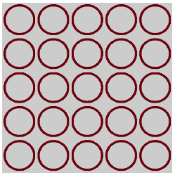
Step 2 : Mapping the Texture on a Plane
glTexCoord2f(0.0, 0.0);
glVertex3f(-1.0, -1.0, 0.0);
glTexCoord2f(0.0, 5.0);
glVertex3f(-1.0, 1.0, 0.0);
glTexCoord2f(5.0, 5.0);
glVertex3f(1.0, 1.0, 0.0);
glTexCoord2f(5.0, 0.0);
glVertex3f(1.0, -1.0, 0.0);
(0, 5)
(5, 5)
→
(-1, 1,0)
(1, 1,0)
→
→
→
(0, 0)
(5, 0)
(-1, -1,0)
(1, -1,0)

Slide 33
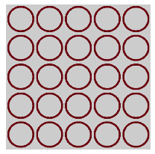
……Calculate your mapping first
glBegin(GL_QUADS);
glTexCoord2f(0.0, 0.0);
glVertex3f(-1.0, -1.0, 0.0);
glTexCoord2f(0.0, 5.0);
glVertex3f(-1.0, 1.0, 0.0);
glTexCoord2f(5.0, 5.0);
glVertex3f(1.0, 1.0, 0.0);
glTexCoord2f(5.0, 0.0);
glVertex3f(1.0, -1.0, 0.0);
glEnd();

Slide 34
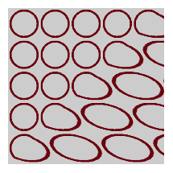
……Calculate your mapping first
glBegin(GL_QUADS);
glTexCoord2f(0.0, 0.0);
glVertex3f(-1.0, -1.0, 0.0);
glTexCoord2f(0.0, 5.0);
glVertex3f(-1.0, 1.0, 0.0);
glTexCoord2f(5.0, 5.0);
glVertex3f(1.0, 1.0, 0.0);
glTexCoord2f(3.0, 0.0);
glVertex3f(1.0, -1.0, 0.0);
glEnd();

Slide 35
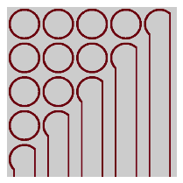
……Calculate your mapping first
glBegin(GL_QUADS);
glTexCoord2f(0.0, 0.0);
glVertex3f(-1.0, -1.0, 0.0);
glTexCoord2f(0.0, 5.0);
glVertex3f(-1.0, 1.0, 0.0);
glTexCoord2f(5.0, 5.0);
glVertex3f(1.0, 1.0, 0.0);
//glTexCoord2f(3.0, 0.0);
glVertex3f(1.0, -1.0, 0.0);
glEnd();

Slide 36
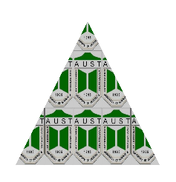

…….More
glBegin(GL_TRIANGLES);
glTexCoord2f(0.0, 0.0);
glVertex3f(-1.0, -1.0, 0.0);
glTexCoord2f(2.5, 2.5);
glVertex3f(0.0, 1.0, 0.0);
glTexCoord2f(5.0, 0.0);
glVertex3f(1.0, -1.0, 0.0);
glEnd();
U,V = (2.5, 2.5)
X,Y = (0.0, 1.0, 0.0)
U,V = (0.0, 0.0)
U,V = (5.0, 0.0)
X,Y = (-1.0, -1.0, 0.0)
X,Y = (1.0, -1.0, 0.0)

Slide 37
And At Last
glTexParameteri(GL_TEXTURE_2D, GL_TEXTURE_MIN_FILTER, ______________);
glTexParameteri(GL_TEXTURE_2D, GL_TEXTURE_MAG_FILTER, ______________);
pixel from Texture
pixel from Quad
GL_NEAREST (average of neighbor pixels)
GL_LINEAR (directly block)

Slide 38
Key Press Handling

Slide 39
Alphanumeric Keys
int main(int iArgc, char** cppArgv)
{
……………
glutKeyboardFunc(handleKeypress)
…………….
}

Slide 40
Alphanumeric Keys
int main(int iArgc, char** cppArgv)
{
……………
glutKeyboardFunc(handleKeypress)
…………….
}
Function that receive keyboard input

Slide 41
Alphanumeric Keys
int main(int iArgc, char** cppArgv)
{
……………
glutKeyboardFunc(handleKeypress)
…………….
}
Function where the action against a key press is defined

Slide 42
Alphanumeric Keys
int main(int iArgc, char** cppArgv)
{
……………
glutKeyboardFunc(handleKeypress)
…………….
}
void handleKeypress(unsigned char key, int x, int y) {
switch (key) {
case 'a':
_angle = _angle + 45.0;
glutPostRedisplay();
} }
Function where the action against a key press is defined

Slide 43
Alphanumeric Keys
int main(int iArgc, char** cppArgv)
{
……………
glutKeyboardFunc(handleKeypress)
…………….
}
void handleKeypress(unsigned char key, int x, int y) {
switch (key) {
case 'a':
_angle = _angle + 45.0;
glutPostRedisplay();
} }
Which key has been pressed
(x, y) Coordinates of cursor while the key is being pressed

Slide 44
Alphanumeric Keys
int main(int iArgc, char** cppArgv)
{
……………
glutKeyboardFunc(handleKeypress)
…………….
}
float _angle = 0.0;
void handleKeypress(unsigned char key, int x, int y) {
switch (key) {
case 'a':
_angle = _angle + 45.0;
glutPostRedisplay();
} }

Slide 45
Alphanumeric Keys
int main(int iArgc, char** cppArgv)
{
……………
glutKeyboardFunc(handleKeypress)
…………….
}
float _angle = 0.0;
void handleKeypress(unsigned char key, int x, int y) {
switch (key) {
case 'a':
_angle = _angle + 45.0;
glutPostRedisplay();
} }
void Draw() {
………………..
glRotatef(_angle, 0.0, 0.0, 1.0);
glBegin(GL_POINTS);
glVertex3f(0.5, 0.0, 0.0);
glEnd();
………………
}

Slide 46
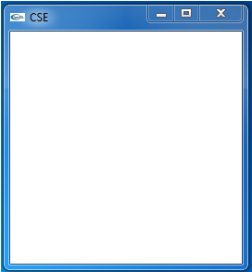
Alphanumeric Keys
int main(int iArgc, char** cppArgv)
{
……………
glutKeyboardFunc(handleKeypress)
…………….
}
float _angle = 0.0;

Slide 47

Alphanumeric Keys
int main(int iArgc, char** cppArgv)
{
……………
glutKeyboardFunc(handleKeypress)
…………….
}
float _angle = 45.0;

Slide 48
Alphanumeric Keys
int main(int iArgc, char** cppArgv)
{
……………
glutKeyboardFunc(handleKeypress)
…………….
}
float _angle = 90.0;

Slide 49
Special Keys
int main(int iArgc, char** cppArgv)
{
……………
glutSpecialFunc(handleKeypress)
…………….
}
Function that receive special keyboard input (e.g. left arrow, right arrow, F2 button etc)

Slide 50
Special Keys
int main(int iArgc, char** cppArgv)
{
……………
glutSpecialFunc(handleKeypress)
…………….
}
Function where the action against a special key-press is defined

Slide 51
Special Keys
int main(int iArgc, char** cppArgv)
{
……………
glutSpecialFunc(handleKeypress)
…………….
}
void handleKeypress(int key, int x, int y) {
switch (key) {
case GLUT_KEY_RIGHT:
…………………
} }

Slide 52
Special Keys
int main(int iArgc, char** cppArgv)
{
……………
glutSpecialFunc(handleKeypress)
…………….
}
void handleKeypress(int key, int x, int y) {
switch (key) {
case GLUT_KEY_RIGHT:
…………………
} }
Which key has been pressed (data type is ‘int’)

Slide 53
Special Keys
int main(int iArgc, char** cppArgv)
{
……………
glutSpecialFunc(handleKeypress)
…………….
}
void handleKeypress(int key, int x, int y) {
switch (key) {
case GLUT_KEY_RIGHT:
…………………
} }
Constant for Right Arrow Key

Slide 54
Special Keys
For Other Special Keys :
GLUT_KEY_F1 F1 function key.
GLUT_KEY_F2 F2 function key.
GLUT_KEY_F3 F3 function key.
GLUT_KEY_F4 F4 function key.
GLUT_KEY_F5 F5 function key.
GLUT_KEY_F6 F6 function key.
GLUT_KEY_F7 F7 function key.
GLUT_KEY_F8 F8 function key.
GLUT_KEY_F9 F9 function key.
GLUT_KEY_F10 F10 function key.
GLUT_KEY_F11 F11 function key.
GLUT_KEY_F12 F12 function key.
GLUT_KEY_LEFT Left directional key.
GLUT_KEY_UP Up directional key.
GLUT_KEY_RIGHT Right directional key.
GLUT_KEY_DOWN Down directional key.
GLUT_KEY_PAGE_UP Page up directional key.
GLUT_KEY_PAGE_DOWN Page down directional key.
GLUT_KEY_HOME Home directional key.
GLUT_KEY_END End directional key.
GLUT_KEY_INSERT Inset directional key.
void handleKeypress(int key, int x, int y) {
switch (key) {
case GLUT_KEY_RIGHT:
…………………
} }

Slide 55
Mouse Event Handling

Slide 56
Mouse Events
int main(int iArgc, char** cppArgv)
{
……………
glutMouseFunc(handleMouseClick);
…………….
}
Function that receive mouse input

Slide 57
Mouse Events
int main(int iArgc, char** cppArgv)
{
……………
glutMouseFunc(handleMouseClick);
…………….
}
Function where the action against a mouse event is defined

Slide 58
Mouse Events
int main(int iArgc, char** cppArgv)
{
……………
glutMouseFunc(handleMouseClick);
…………….
}
void handleMouseClick(int button, int state, int x, int y)
{
if (button == GLUT_LEFT_BUTTON)
{
if (state == GLUT_DOWN)
printf("clicked at (%d, %d)\n", x, y);
}
}
Function where the action against a mouse event is defined

Slide 59
Mouse Events
int main(int iArgc, char** cppArgv)
{
……………
glutMouseFunc(handleMouseClick);
…………….
}
void handleMouseClick(int button, int state, int x, int y)
{
if (button == GLUT_LEFT_BUTTON)
{
if (state == GLUT_DOWN)
printf("clicked at (%d, %d)\n", x, y);
}
}
On which Button the event is being occurred (Left, Right or Middle)

Slide 60
Mouse Events
int main(int iArgc, char** cppArgv)
{
……………
glutMouseFunc(handleMouseClick);
…………….
}
void handleMouseClick(int button, int state, int x, int y)
{
if (button == GLUT_LEFT_BUTTON)
{
if (state == GLUT_DOWN)
printf("clicked at (%d, %d)\n", x, y);
}
}
What is the condition of the event (Down/ Up)

Slide 61
Mouse Events
int main(int iArgc, char** cppArgv)
{
……………
glutMouseFunc(handleMouseClick);
…………….
}
void handleMouseClick(int button, int state, int x, int y)
{
if (button == GLUT_LEFT_BUTTON)
{
if (state == GLUT_DOWN)
printf("clicked at (%d, %d)\n", x, y);
}
}
What is the coordinate of the cursor on the window while the event is being occurred

Slide 62
Mouse Events
int main(int iArgc, char** cppArgv)
{
……………
glutMouseFunc(handleMouseClick);
…………….
}
void handleMouseClick(int button, int state, int x, int y)
{
if (button == GLUT_LEFT_BUTTON)
{
if (state == GLUT_DOWN)
printf("clicked at (%d, %d)\n", x, y);
}
}

Slide 63
Mouse Events
int main(int iArgc, char** cppArgv)
{
……………
glutMouseFunc(handleMouseClick);
…………….
}
void handleMouseClick(int button, int state, int x, int y)
{
if (button == GLUT_LEFT_BUTTON)
{
if (state == GLUT_DOWN)
printf("clicked at (%d, %d)\n", x, y);
}
}
GLUT_LEFT_BUTTON
GLUT_MIDDLE_BUTTON
GLUT_RIGHT_BUTTON

Slide 64
Mouse Events
int main(int iArgc, char** cppArgv)
{
……………
glutMouseFunc(handleMouseClick);
…………….
}
void handleMouseClick(int button, int state, int x, int y)
{
if (button == GLUT_LEFT_BUTTON)
{
if (state == GLUT_DOWN)
printf("clicked at (%d, %d)\n", x, y);
}
}

Slide 65
Mouse Events
int main(int iArgc, char** cppArgv)
{
……………
glutMouseFunc(handleMouseClick);
…………….
}
void handleMouseClick(int button, int state, int x, int y)
{
if (button == GLUT_LEFT_BUTTON)
{
if (state == GLUT_DOWN)
printf("clicked at (%d, %d)\n", x, y);
}
}
GLUT_DOWN
GLUT_UP

Slide 66
Mouse Events
int main(int iArgc, char** cppArgv)
{
……………
glutMouseFunc(handleMouseClick);
…………….
}
void handleMouseClick(int button, int state, int x, int y)
{
if (button == GLUT_LEFT_BUTTON)
{
if (state == GLUT_DOWN)
printf("clicked at (%d, %d)\n", x, y);
}
}

Slide 67
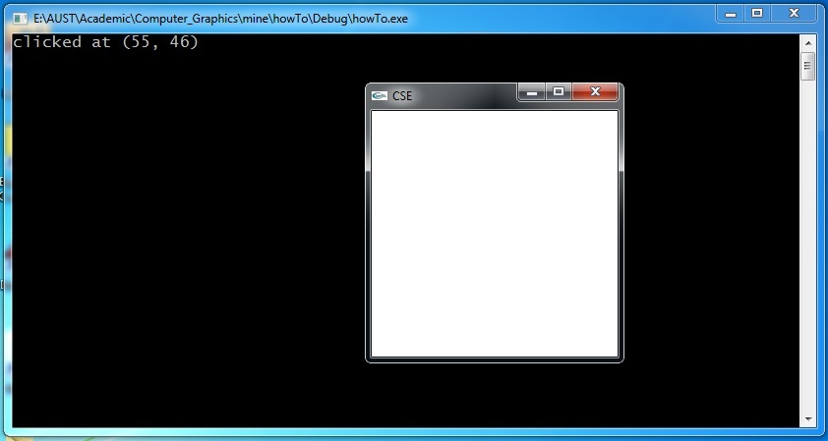
Mouse Events
int main(int iArgc, char** cppArgv)
{
……………
glutMouseFunc(handleMouseClick);
…………….
}
(0, 0)

Slide 68

Mouse Events
int main(int iArgc, char** cppArgv)
{
……………
glutMouseFunc(handleMouseClick);
…………….
}

Slide 69
THANK YOU

